Slide 1
Progress Report
Yzm
08/21/2020

Slide 2
METIER
METIER: A Deep Multi-Task Learning
Based Activity and User Recognition Model
Using Wearable Sensors
LING CHEN*
Zhejiang University
YI ZHANG
Zhejiang University
LIANGYING PENG Zhejiang University
(IMWUT’20)Proc. ACM Interact. Mob. Wearable Ubiquitous Technol.
Vol. 4, No. 1, Article 5. Publication date: March 2020.
Notes:
周安福，北京邮电大学计算机学院教授，博士生导师, 智能感知、物联网系统、AI-driven数据传输

Slide 3
Related Work
Activity Recognition Using Wearable Sensors | Non-personalized AR | Picking out user-independent features | Saputri et al. [1]
 | Personalized AR | Trains a private model for each user | Sun et al. [2]
User Recognition Using Wearable Sensors | Template based methods | Builds templates for each user | Derawi et al. [3]
 | ML based methods | Choi et al. [4]
Multi-Task Learning | Soft parameter sharing | Obozinski et al. [5]
 | Hard parameter sharing | Caruana [6]
[1] Theresia Ratih Dewi Saputri, Adil Mehmood Khan, and Seok-Won Lee. 2014. User-independent activity recognition via three-stage GA-based feature selection. International Journal of Distributed Sensor Networks 10, 3 (2014), 706287.
[2] Xu Sun, Hisashi Kashima, Ryota Tomioka, Naonori Ueda, and Ping Li. 2011. A new multi-task learning method for personalized activity recognition. In Proceedings of the 11th IEEE International Conference on Data Mining. IEEE, 1218–1223.
[3] Mohammad Omar Derawi, Claudia Nickel, Patrick Bours, and Christoph Busch. 2010. Unobtrusive user-authentication on mobile phones using biometric gait recognition. In Proceedings of the 6th International Conference on Intelligent Information Hiding and Multimedia Signal Processing. IEEE, 306–311.
[4] Sangil Choi, Ik-Hyun Youn, Richelle LeMay, Scott Burns, and Jong-Hoon Youn. 2014. Biometric gait recognition based on wireless acceleration sensor using
k-nearest neighbor classification. In Proceedings of the 3rd International Conference on Computing, Networking and Communications. IEEE, 1091–1095.
[5] Guillaume Obozinski, Ben Taskar, and Michael Jordan. 2006. Multi-task feature selection. Statistics Department, UC Berkeley,Technical Report 2 (2006).
[6] Rich Caruana. 1997. Multitask learning. Machine Learning 28, 1 (1997), 41–75.

Slide 4
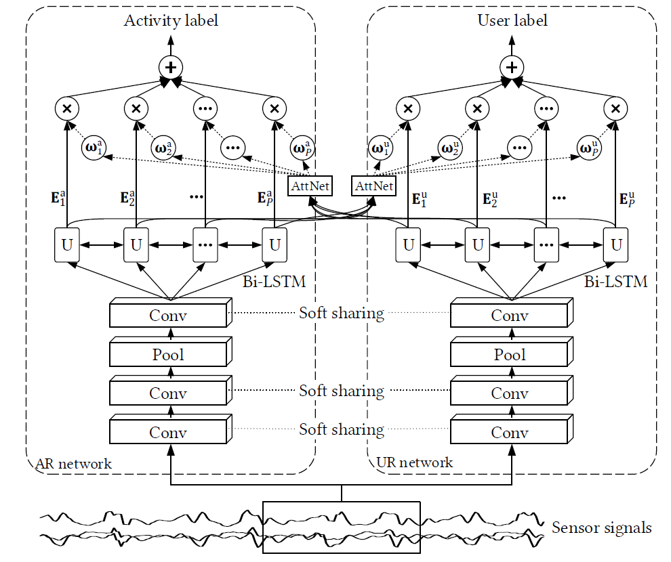
Framework

Slide 5
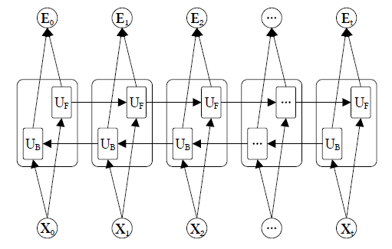
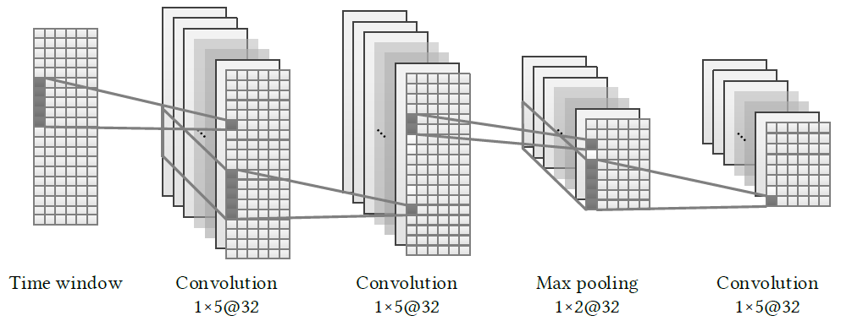
CNN & Bi-LSTM

Slide 6

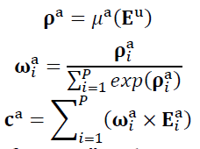
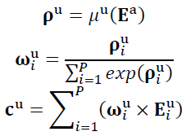
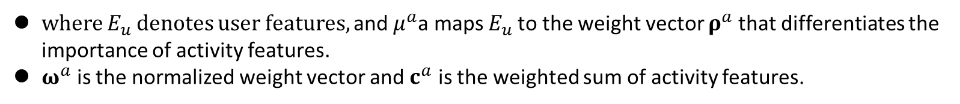
Soft sharing & Mutual Attention
Soft parameter sharing
The stack of the convolution filters in AR and UR networks can be represented by a 4-way tensor 𝐖 with the size of 𝑑1 × 𝑑2 × 𝑑3 × 𝑑4 (𝑑4 = 2) , Tucker decomposition as follow:
where 𝐒 is a core tensor with the size of 𝑣1 × 𝑣2 × 𝑣3 × 𝑣4 , and $R^{(i)}$denotes a matrix with the size of $d_{i}$ x $v_{i}$.
Mutual Attention
where $E_{u}$denotes user features, and ${\text{μ}}^{a}$a maps $E_{u}$to the weight vector ${\text{ρ}}^{a}$that differentiates the importance of activity features.
${\text{ω}}^{a}$ is the normalized weight vector and ${\text{c}}^{a}$ is the weighted sum of activity features.

Slide 7
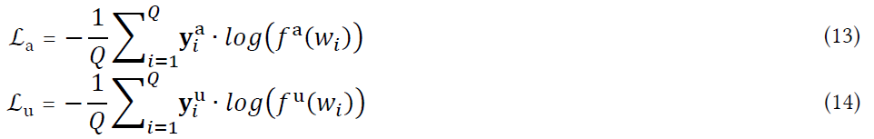
Loss Fuction
Two losses ℒa and ℒu are defined for AR and UR networks, respectively, which are given formally by Equations 13 and 14:
Combine two losses above into a global loss ℒg and use it to update METIER model. ℒg is given formally by Equation 15:
The learning rate 𝑙 is dynamically controlled by a decreasing function, which is given formally by Equation 16:

Slide 8
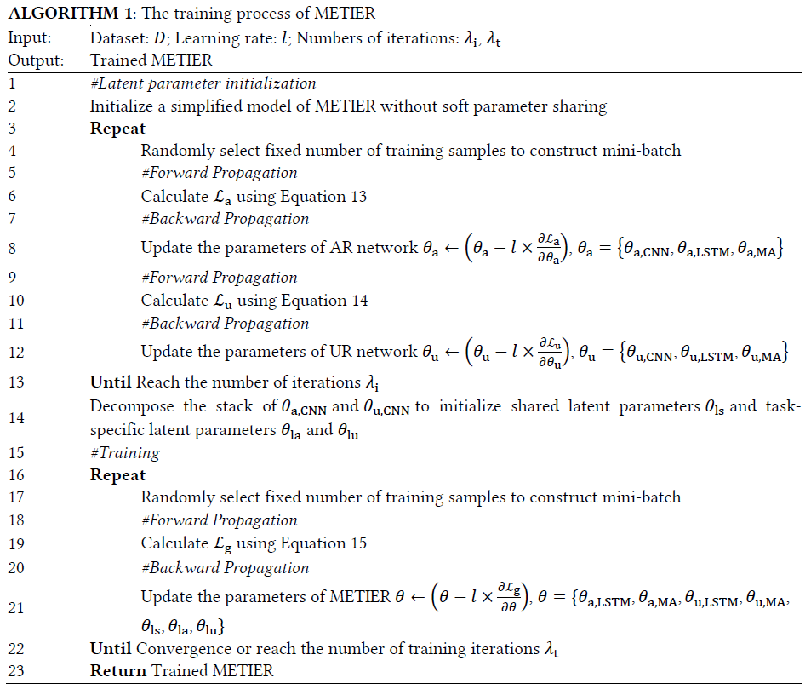
Training

Slide 9
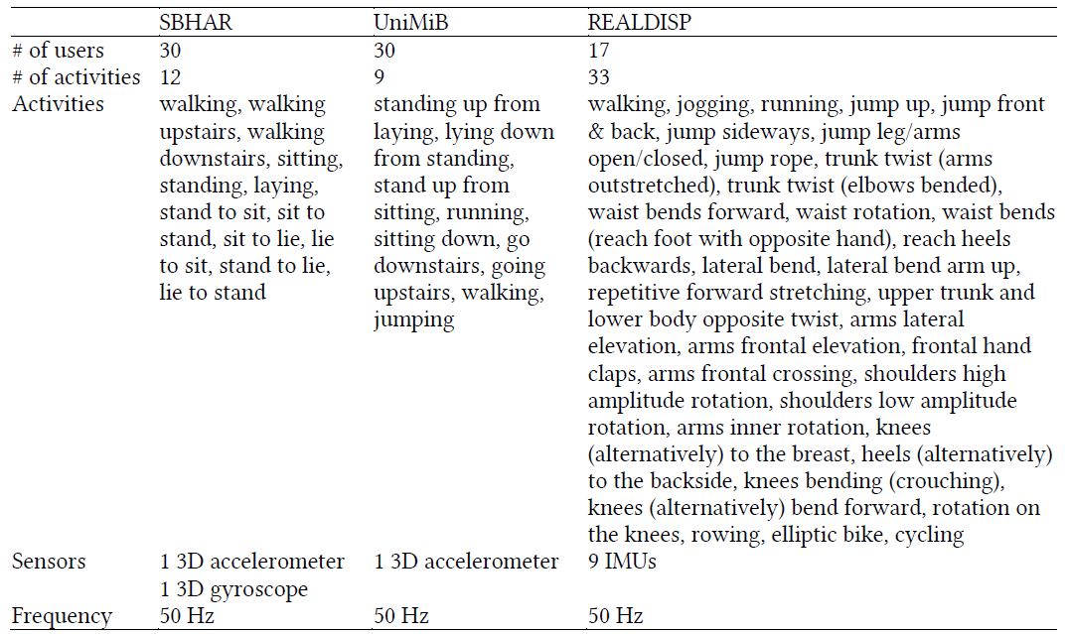
Datasets

Slide 10
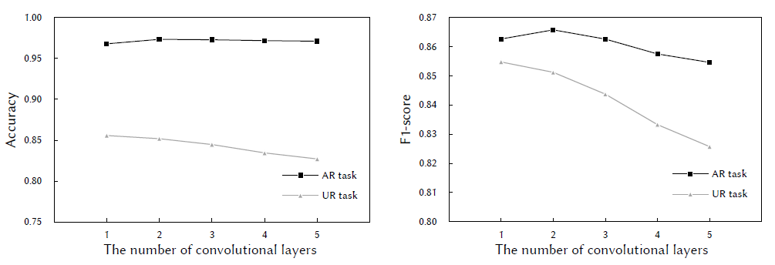
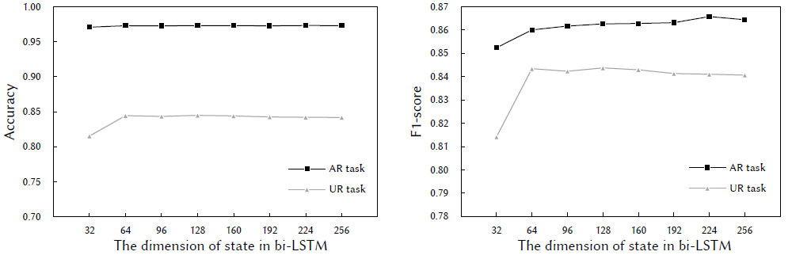
Parameter Evaluation

Slide 11
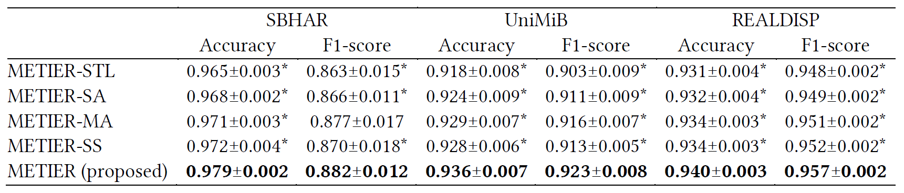
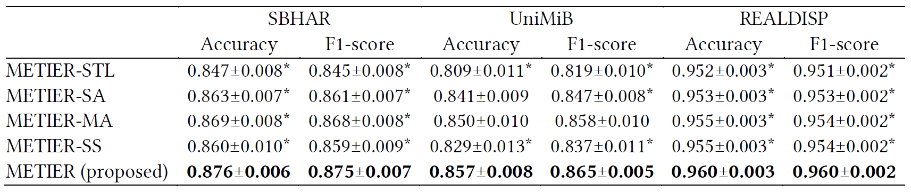
Comparison with Simplified Models

Slide 12
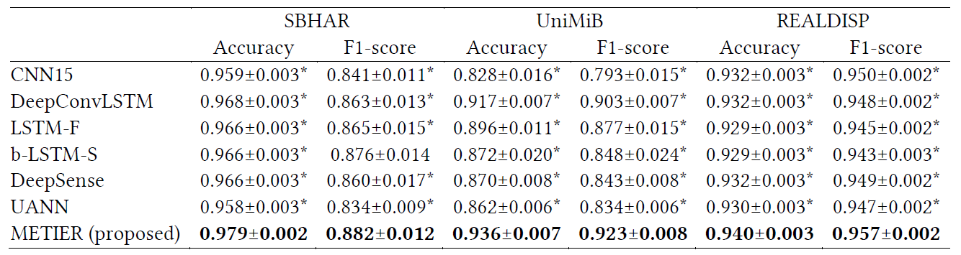
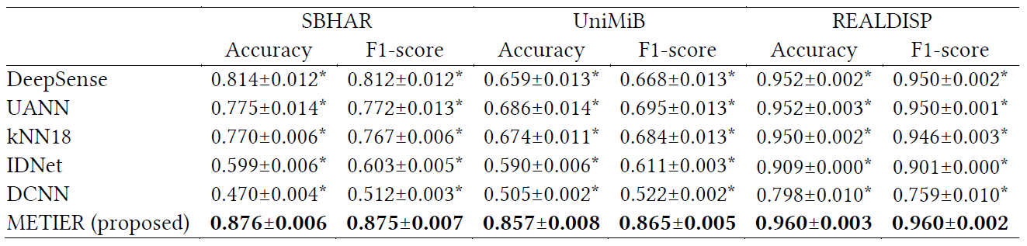
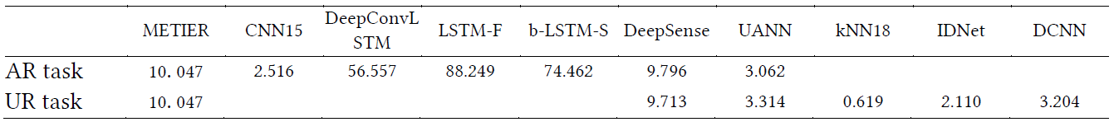
Comparison with Other AR and UR Models

Slide 13
Summary
Key point：Utilizing soft parameter sharing and mutual attention mechanism to improve performance of each task.
There are many kind of methods to share parameter. The next step is to explore new parameter sharing methods.
More related tasks need to explore like sensor direction recognition and sensor placement recognition.

Slide 14
Thanks!

Slide 15














共享参数
独有参数
Tucker分解
S
$$R^{(1)}$$
$$R^{(2)}$$
$$R^{(3)}$$
$$R^{(4)}$$
1x5x32
W:1x5x32x2
$d_{1}$x $d_{2}$x $d_{3}$x $d_{4}$
$${1xd}_{1}$$
5x$d_{2}$
32x$d_{3}$
2x$d_{4}$
将第一个张量的第一维和第二个张量的第二维消去
1x5x32

